Slide 1
ShiftXpress
Team Members :-1. Dhara Bhanushali(1006)
2.Disha Bundela (1013)
3.Nensi Dobariya (1015)
4.Foram Maru (1016)
5.Palak Patel (1042)
Project Mentor :- Prof.Javani Shah

Slide 2
Introduction:-
The system is controlled by the Admin, who manages User approvals,and provides drivers and vehicles. Admin ensures smooth coordination so that every request is handled quickly and efficiently.
“Admin at the center, service made simpler.”

Slide 3
Objective:-
To provide a centralized system where the Admin manages ,User, drivers, and vehicles.
To ensure quick Approval of client requests through Admin monitoring.
To assign the right driver, and vehicle as per client need.
To maintain a proper record of Members, cities and vehicles for smooth operations.
To make the process efficient, reliable, and User friendly.

Slide 4
Existing System:-
Most of the work is handled manually.
User directly contact drivers without proper approval.
No center authority ( Admin) to monitor requests.
Records are kept in paper or simple files , not in a system
Difficult to drivers and vehicles properly.
Leads to mismanagement , duplication of data , and delays .

Slide 5
Problems Of Existing System:-
No central control – User directly contact drivers, causing confusion.
Manual process – increases workload and chances of mistakes.
Poor record management – data is kept in papers/files, making tracking difficult.
Delays in service – no proper system to assign drivers or vehicles quickly.
Data duplication – same information may be recorded multiple times.
Lack of reliability – miscommunication between clients, agents, and drivers.
No transparency – clients cannot track the status of their request.

Slide 6
Proposed System:-
Admin as central controller
Digital record keeping
Quick user approval
Proper assignment
Reduced errors
Transparency & reliability

Slide 7
Scope:-
Provide a centralized for all users.
Serviceable ZIP codes within a particular city.
digital record-keeping .
transparency, reliability, and efficiency.

Slide 8
Role of Admin:-
Login with secure credentials.
Manage user accounts (user,drivers).
Approve/Reject user requests.
Assign drivers, and vehicles.
Generate and view reports.

Slide 9
Role Of User :-
Register & Login to the system.
Send service request.
View request/approval status.
Make payment.

Slide 10
Features:-
Centralized Control
Client Approval System
Driver & Vehicle Assignment
Digital Database
Error Reduction
User-Friendly Interface
Transparency

Slide 11
Modules & Sub Modules:-
Admin Module
User Module
Booking Module
Payment Module
Zipcode Module
Driver Module
Vehicle Module

Slide 12
Admin Module:-
Admin is the central controller of the system. It manages clients,
agents, drivers, and vehicles to ensure smooth operation.
Sub-Modules:
Login & Authentication
User Management (approve/reject requests)
Booking Management (add/update/delete agents)
Driver Management (assign trips, manage availability)
Vehicle Management (add/update vehicles, maintenance records)
Report Generation

Slide 13
User Module:-
Handles user registration login profile management , and booking requests.
Sub-Modules:-
Registration & Login
Booking

Slide 14
Booking Module:-
Manages pickup/drop details, booking confirmation and booking status tracking.
Sub-Modules:-
Booking Validation
Booking Confirmation
Booking Status(Pending/Confirmed/Completed/Canceled)

Slide 15
Payment Module:-
Calculate fare based on distance , processes payments , and generates invoices.
Sub-Modules:
Fare Calculation
Payment Processing
Invoice Generation(Payment date/booking ID link)

Slide 16
Zipcode Management Module:-
Stores serviceable zip codes and validate pickup/drop location during booking.
Sub Module:-
Zipcode List
Validation

Slide 17
Driver Module:-
Drivers provide services to clients and update trip-related activities.
Sub-Modules:-
Driver registration(by admin)
Assign driver to booking
Driver availability status(Available/busy)

Slide 18
Vehicle Module:-
Vehicles are managed as system resources for providing services.
Sub-Modules:-
Vehicle List
Vehicle Assignment

Slide 19
Data Dictionary
User
Booking
Zipcode
Payment
Vehicle
Driver
Admin

Slide 20
Table 1 :- Users
Field | Data Type | Size | Constraint | Description
id | INT | 10 | Primary Key,Auto_Increment | Unique ID to identify each user.
name | VARCHAR | 100 | Not Null | Full name of the user.
email | VARCHAR | 100 | Unique,Not Null | User’s unique email for login/communication.
phone | VARCHAR | 15 | Unique,Not Null | Contact number for calls or verification.
password | VARCHAR | 255 | Not Null | Encrypted password for account security.

Slide 21
Table 2 :- Booking
Field | Data Type | Size | Constraint | Description
booking_id | INT | 10 | Primary Key | Unique ID for each booking
user_id | INT | 10 | Foreign key | Referenced from :- User Links booking to customer.
pickup_city | VARCHAR | 50 | Not Null | City where items will be picked up
pickup_zipcode | VARCHAR | 06 | Not Null | ZIP code for pickup location
pickup_address | VARCHAR | 255 | Not Null | Full pickup address
drop_city | VARCHAR | 50 | Not Null | Destination city for delivery
drop_zipcode | VARCHAR | 06 | Not Null | ZIP code for drop location
drop_address | VARCHAR | 255 | Not Null | Full drop address
date | DATETIME | - | Not Null | Date and time of scheduled shifting.

Slide 22
Table 2 :- Booking
Field | Data Type | Size | Constraint | Description
shift | ENUM | - | Not Null | Time slot(Morning,Noon,Evening)
vehicle_type | VARCHAR | 50 | Not Null | Type of vehicle requied for shifting
driver_id | INT | 10 | Foreign Key | Referenced from :- Driver Assigned driver for the booking
vehicle_id | INT | 10 | Foreign Key | Referenced from :- Vehicle Assigned vehicle for the booking
status | ENUM | - | Default = ‘Pending’ | Booking status(Pending,Confirmed,Completed,Cancelled)
created_at | TIMESTAMP | - | Default = ‘Current_Timestamp’ | Timestamp when booking was created

Slide 23
TABLE 3 :- Zipcode
Field | Data Type | Size | Constraint | Description
zipcode_id | INT | 10 | Primary Key,Auto_Increment | Unique ID for each ZIP code
zipcode | VARCHAR | 06 | Unique,Not Null | Postal or ZIP code value
City | VARCHAR | 50 | Not Null | City associated with the ZIP code

Slide 24
Table 4 :- Payment
Field | Data Type | Size | Constraint | Description
payment_id | INT | 10 | Primary Key,Auto_Increment | Unique ID for each payment
booking_id | INT | 10 | Foreign Key | Referenced from :- Booking. Related booking to which the payment is linked
distance_km | DECIMAL | 6,2 | Not Null | Distance covered for the booking.
rate_per_km | DECIMAL | 5,2 | Not Null | Cost per kilometer.
amount | DECIMAL | 8,2 | Not Null | It is the total payment amount.
payment_status | ENUM | - | Default = ‘Pending’ | Status of payment (Paid,Pending,failed)
payment_date | TIMESTAMP | - | Default =‘Current_Timestamp’ | Timestamp of when the payment was recorded.

Slide 25
Table 5 :- Vehicle
Field | Data Type | Size | Constraint | Description
vehicle_id | INT | 10 | Primary Key,Auto_Increment | Unique ID for each vehicle.
vehicle_no | VARCHAR | 20 | Unique,Not Null | Vehicle registration plate number
vehicle_type | VARCHAR | 50 | Not Null | Type of vehicle (example:- mini truck)
capacity | INT | 6 | Not Null,Check(capacity>0) | Maximum weight capacity that a vehicle can hold.
status | ENUM | - | Default = ‘Available’ | Vehicle availability status (Available or Inactive)

Slide 26
Table 6 : Driver
Field | Data Type | Size | Constraint | Description
driver_id | INT | 10 | Primary Key,Auto_Increment | Unique ID for each driver
name | VARCHAR | 100 | Not Null | Driver’s full name
phone | VARCHAR | 15 | Unique,Not Null | Driver’s contact number for communication.
vehicle_id | INT | 10 | Foreign Key | Referenced from :- Vehicle Assigned vehicle for the driver.
status | ENUM | - | Default = ‘Available’ | Driver’s availability status(Available,On Duty,Inactive)
created_at | TIMESTAMP | - | Default = ‘Current_Timestamp’ | Timestamp when the driver was added.

Slide 27
TABLE 7 :- Admin
Field | Data Type | Size | Constraint | Description
admin_id | INT | 10 | Primary Key,Auto_Increment | Unique ID for each admin
name | VARCHAR | 100 | Not Null | Full name of the admin
phone | VARCHAR | 15 | Unique,Not Null | Contact number of the admin.
email | VARCHAR | 100 | Unique,Not Null | Admin’s email for login
password | VARCHAR | 255 | Not Null | Encrypted admin password
user_id | INT | 10 | Foreign Key | Referenced from :- User. Links admin to user account if shared.

Slide 28
TABLE 7 :- Admin
Field | Data Type | Size | Constraint | Description
booking_id | INT | 10 | Foreign Key | Referenced from :- Booking Booking managed by admin
payment_id | INT | 10 | Foreign Key | Referenced from :- Payment Payment overseen by admin
vehicle_id | INT | 10 | Foreign Key | Referenced from :- Vehicle Vehicle managed by the admin.
driver_id | INT | 10 | Foreign Key | Referenced from :- Driver Driver assigned by the admin
created_at | TIMESTAMP | - | Default =‘Current_Timestamp’ | Timestamp when the admin record was created.

Slide 29
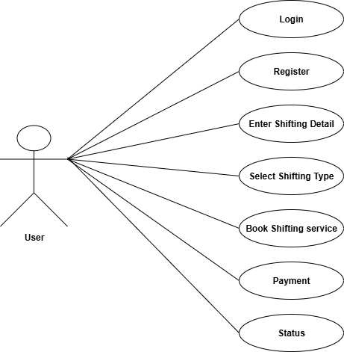
Use-case:- User

Slide 30
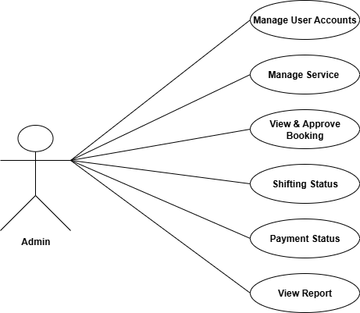
Use-case:- Admin

Slide 31
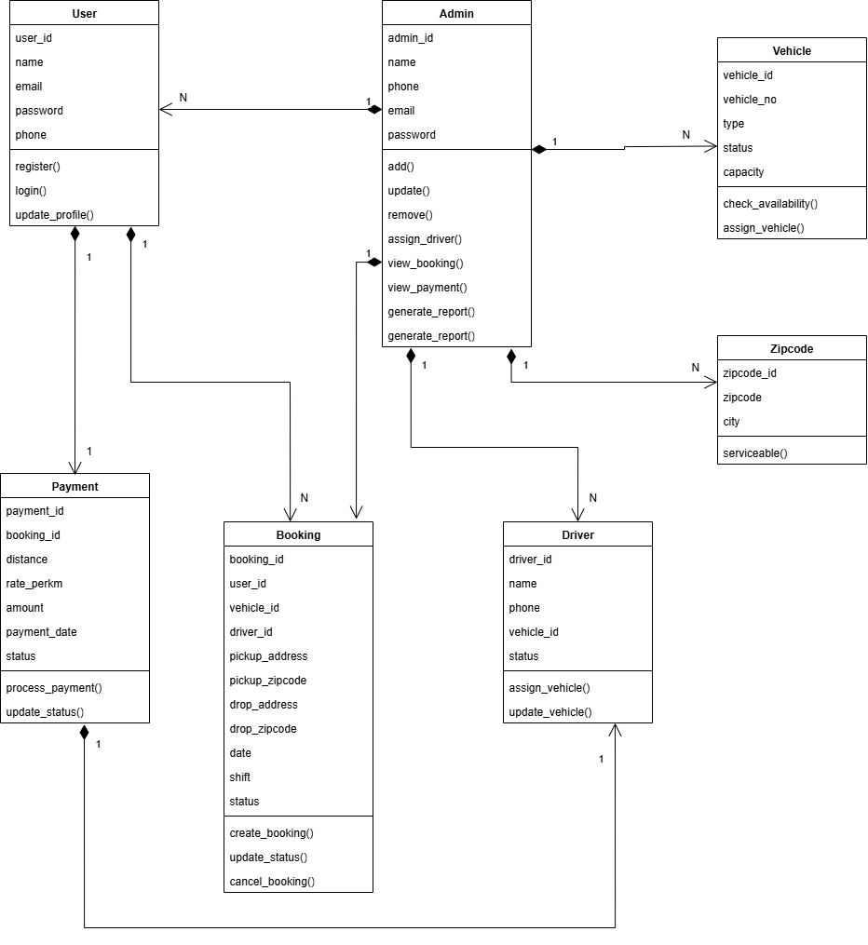
Class Diagram:-

Slide 32
System Design:

Slide 33
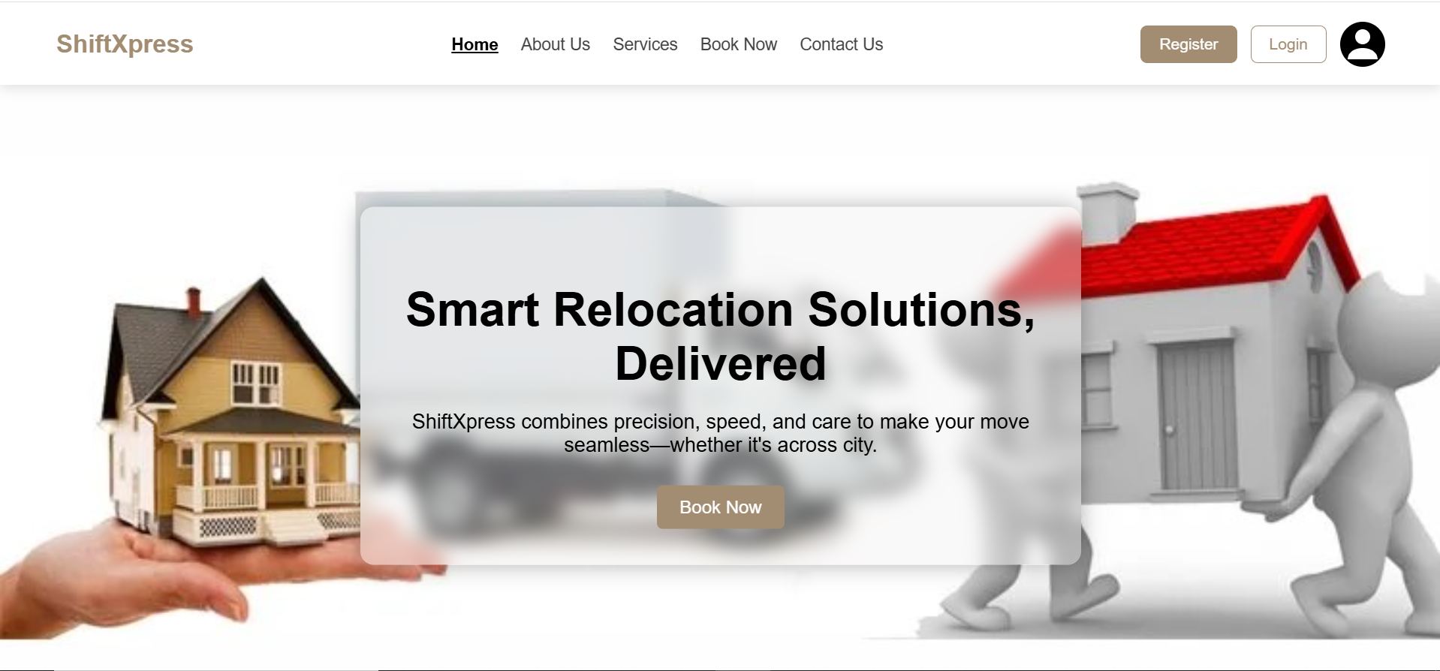

Slide 34
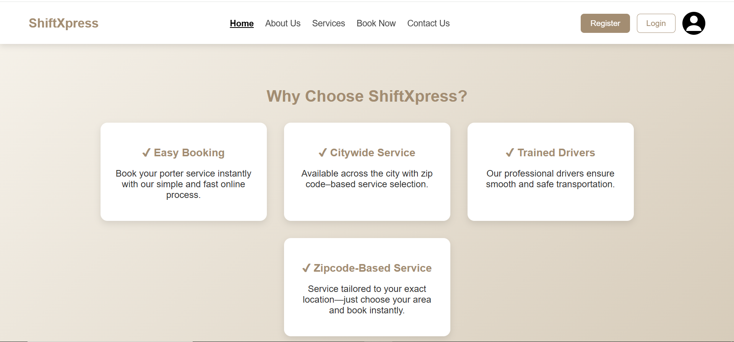

Slide 35
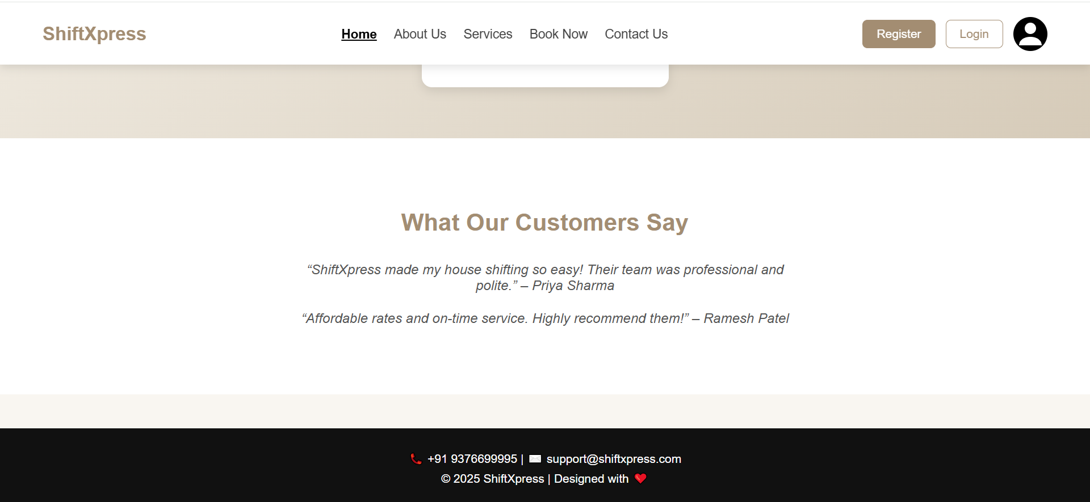

Slide 36
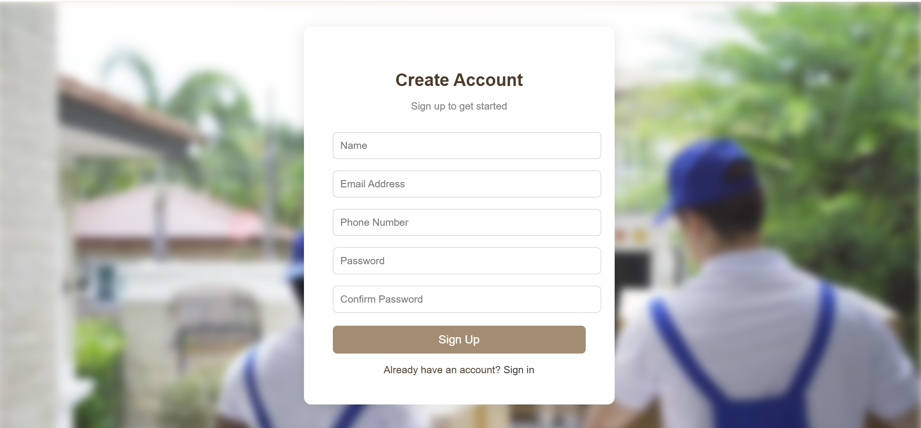

Slide 37
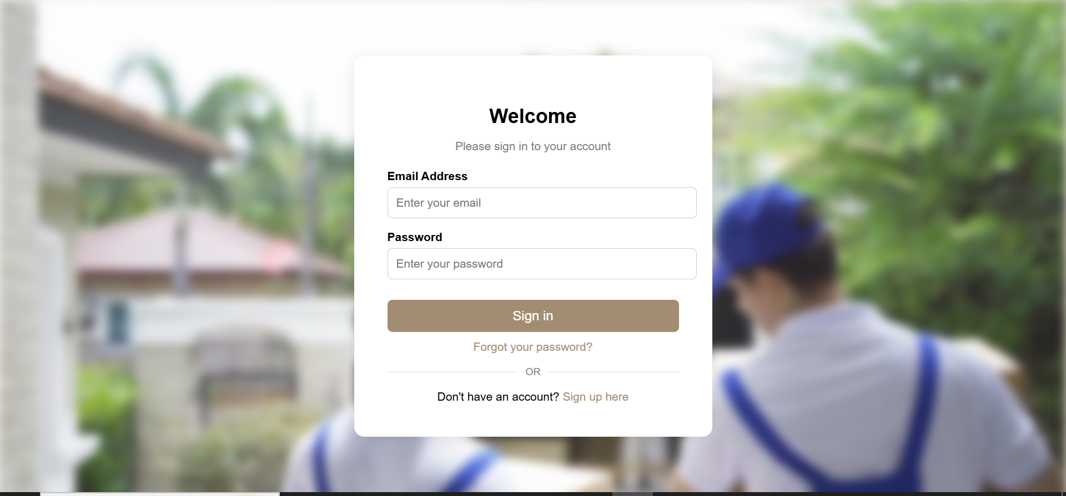

Slide 38
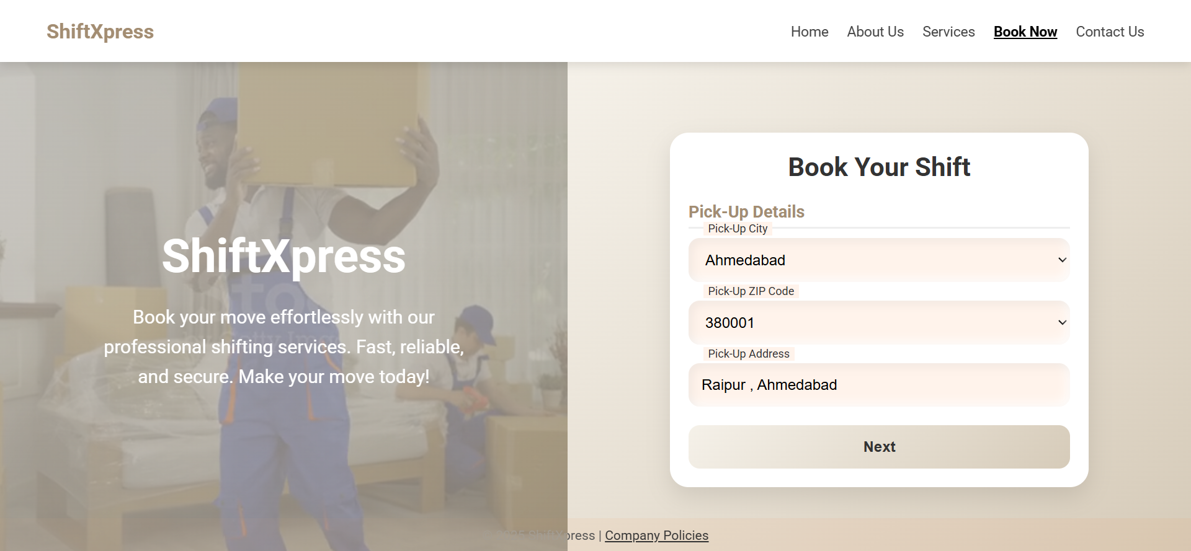

Slide 39
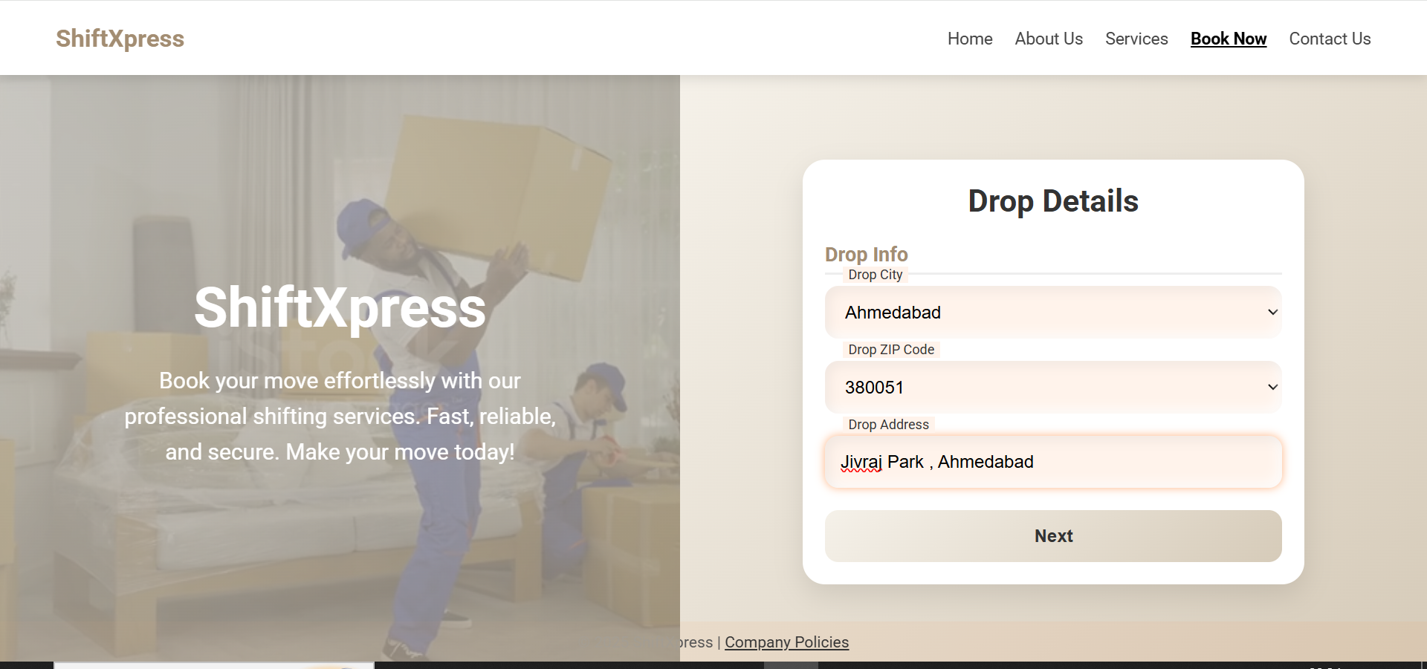

Slide 40
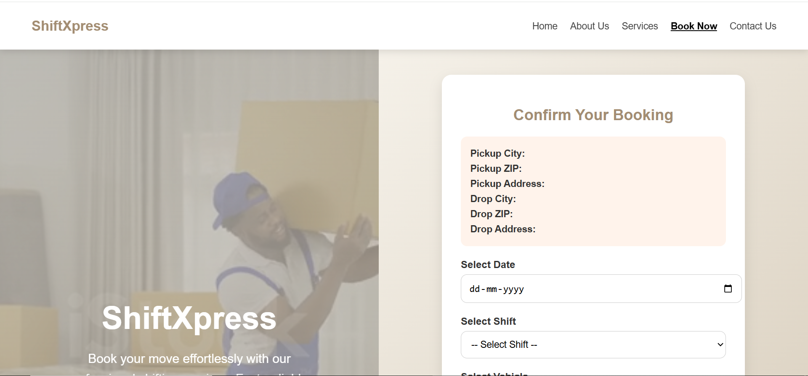

Slide 41
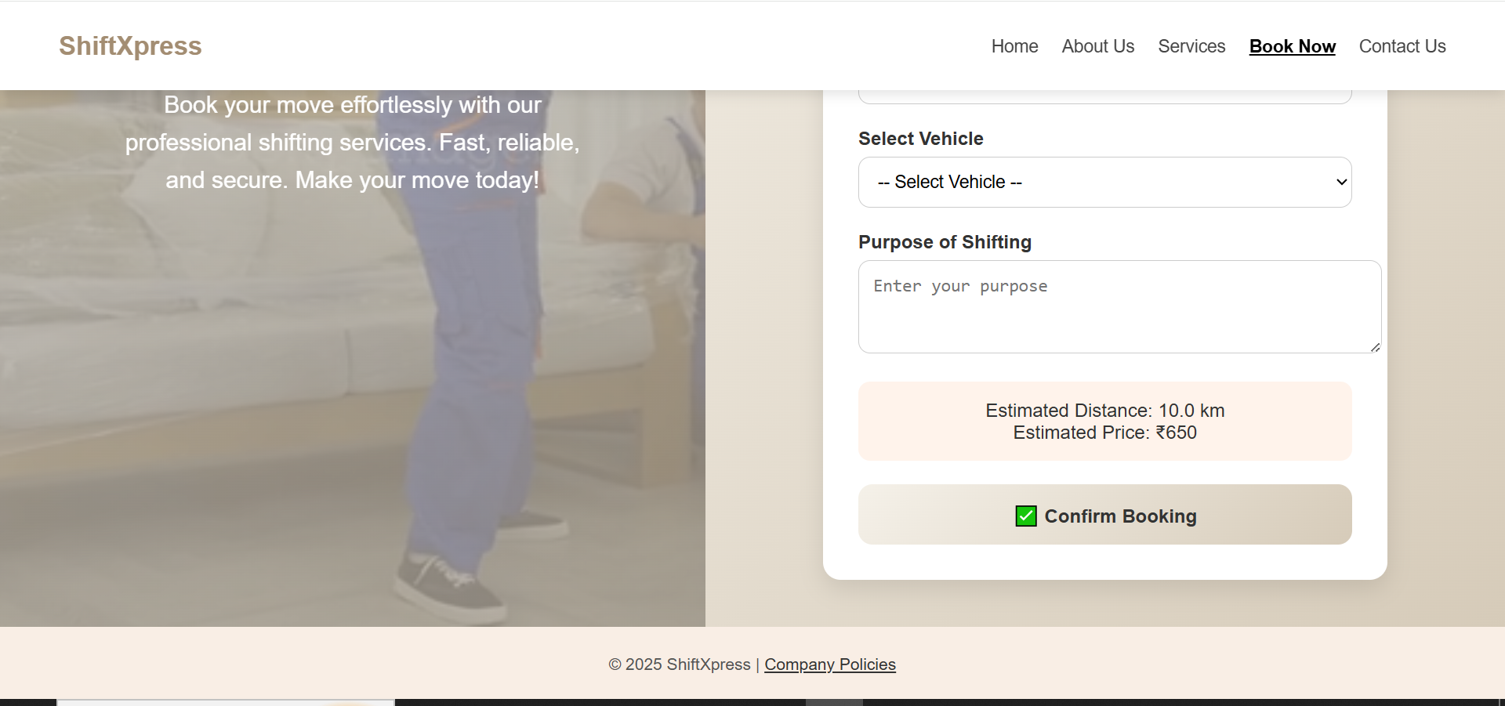

Slide 42
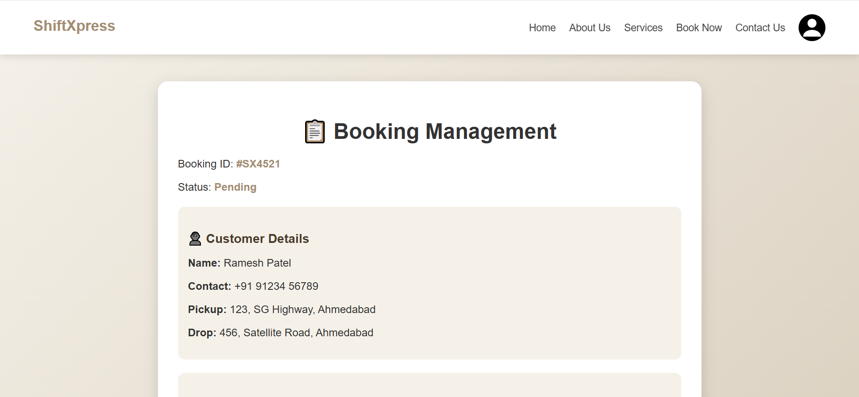

Slide 43
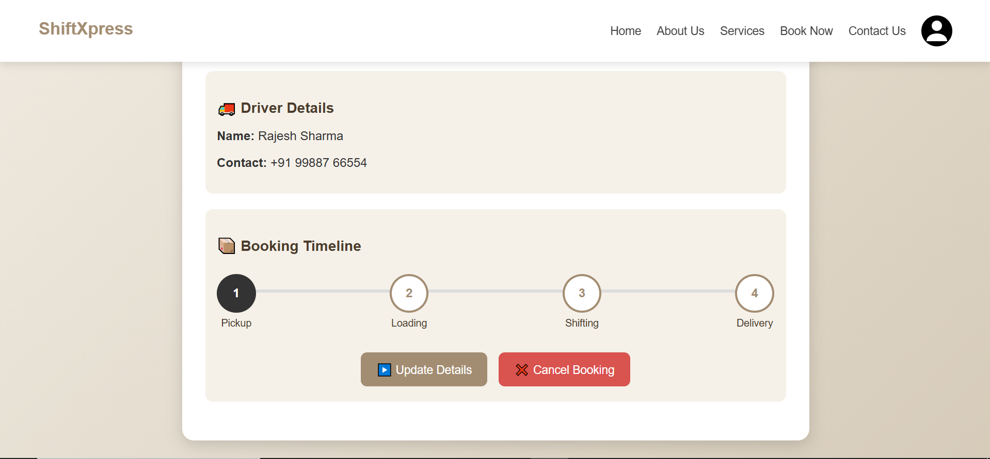

Slide 44
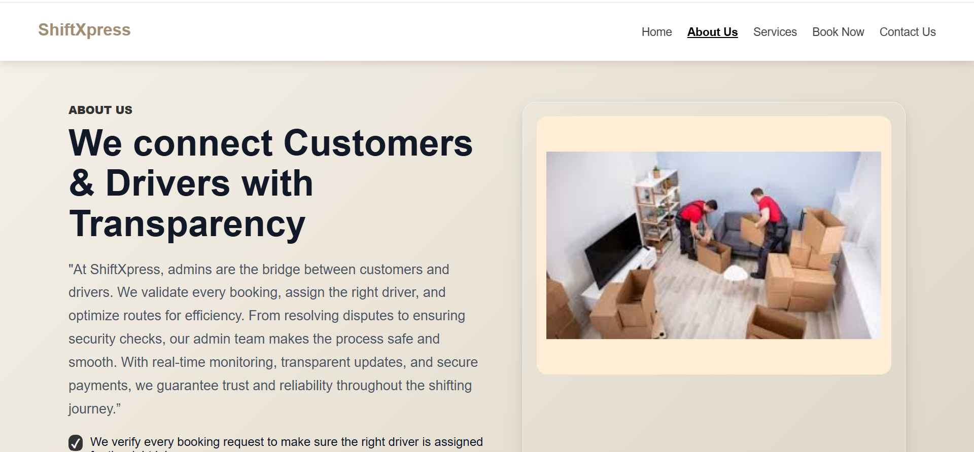

Slide 45
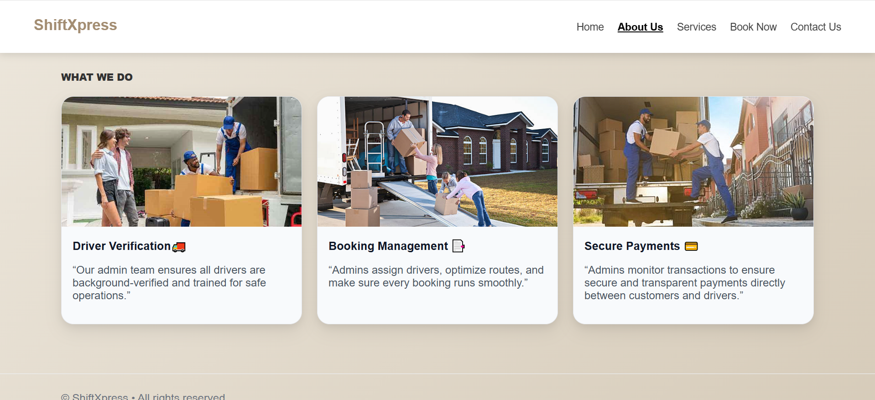

Slide 46
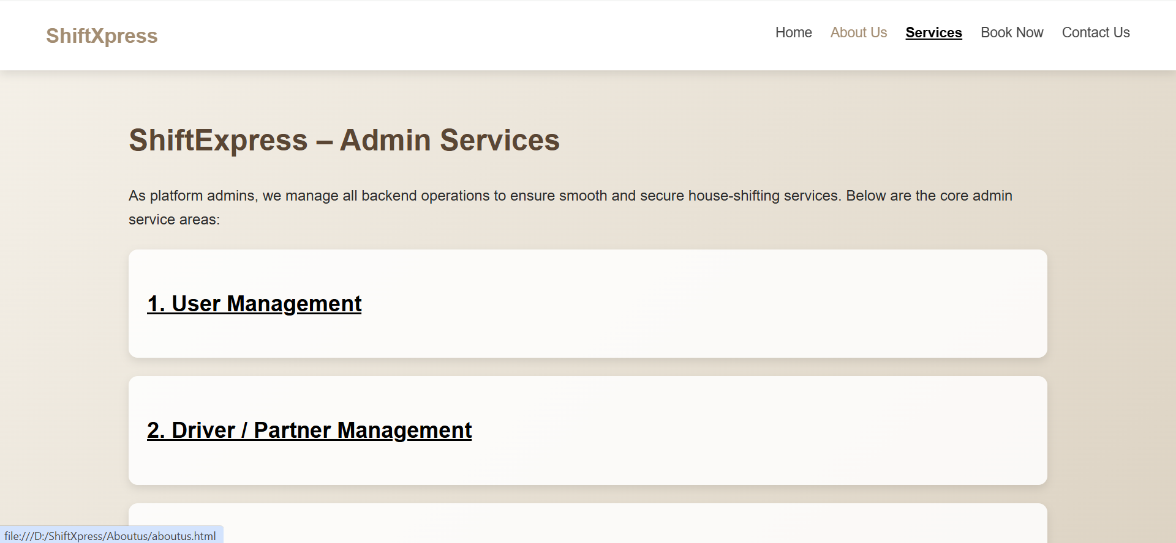

Slide 47
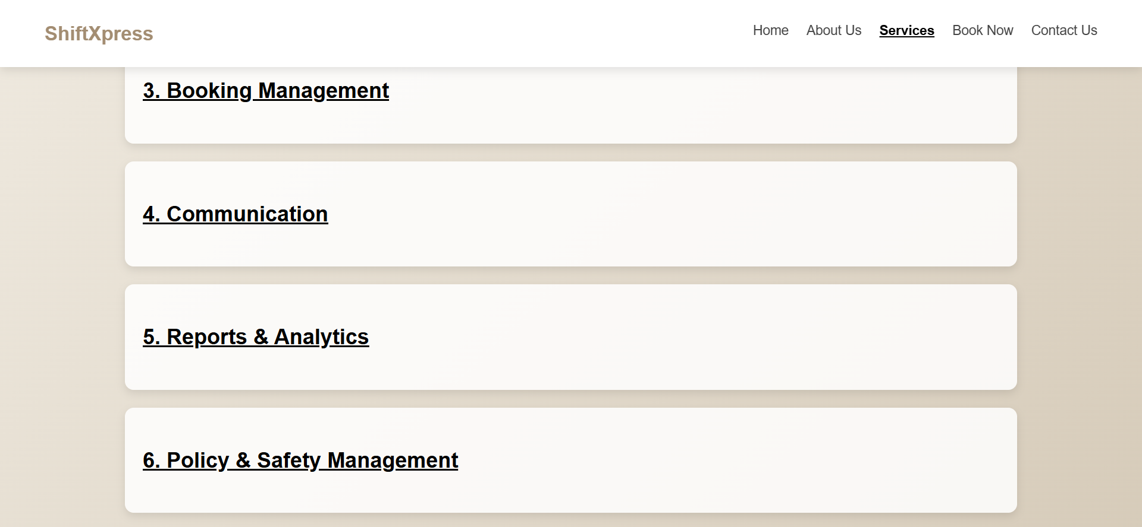

Slide 48
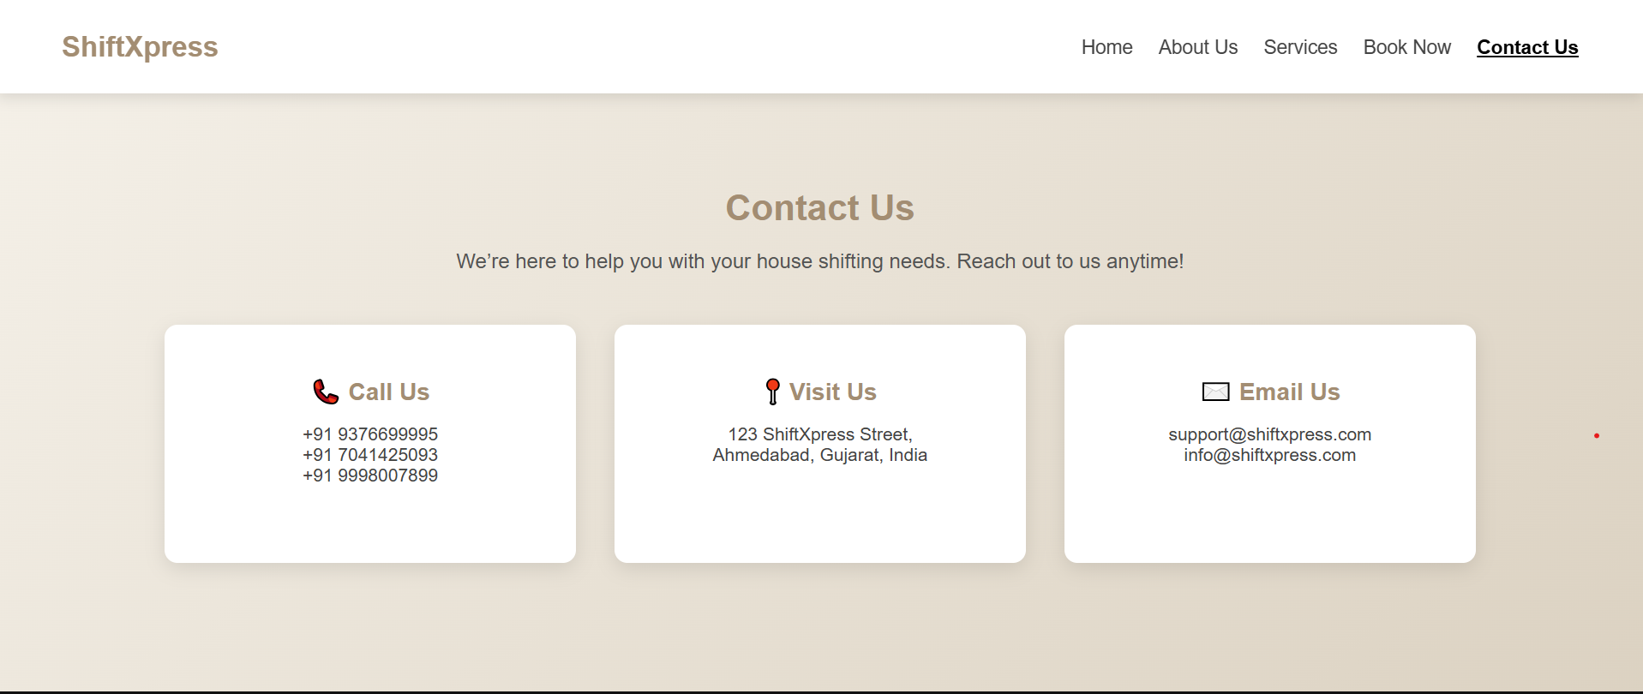

Slide 49
